Slide 1

Green Pace
Security Policy Presentation
Developer: Charlie Vinson
Describing and explaining secure coding practices
in the context of our development team

Slide 2

OVERVIEW: DEFENSE IN DEPTH
Multi-layered approach used to develop our security policy:

Slide 3
THREATS MATRIX
Likely: Faulty functions, unhandled exceptions | Priority: Memory protection, access control, input validation
Low priority: Data range, string correctness | Unlikely: Incorrect data types, no user authentication

Slide 4
10 PRINCIPLES
Validate Input Data…………………………..........
Heed Compiler Warnings…………………............
Architect and Design for Security Policies..........
Keep It Simple………………………………….........
Default Deny…………………………………………
Adhere to the Principle of Least Privilege...........
Sanitize Data Sent to Other Systems……............
Practice Defense in Depth………………………...
Use Effective Quality Assurance Techniques…..
Adopt a Secure Coding Standard……………....
Data Value, SQL Injection, Input Validation
Data Type, Exceptions
SQL Injection, Exceptions
Data Type, Memory Protection, Assertions
SQL Injection, Access Control
Access Control
String Correctness
Assertions, Input Validation
String Correctness, Assertions, Exceptions
Assertions, Exceptions

Slide 5
CODING STANDARDS
Access Control
Memory Protection
SQL Injection
Input Validation
Data Value
Exceptions
Assertions
String Correctness
Data Type
Data Range
These standard are prioritized by their potential to allow users to attack the system or otherwise cause unexpected program behavior.
Threats related to system access, memory integrity, and input validation can allow users to gain unauthorized access to sensitive data.
Developer practices such as exceptions and assertions help to ensure the system will function as expected under normal circumstances.
Correct data types and ranges help to ensure that the program will function as expected even under abnormal circumstances.

Slide 6
ENCRYPTION POLICIES
At Rest:
Refers to data held on storage devices and not being used or accessed by the system.
In Flight:
Refers to data being accessed by the system or otherwise moving through the system.
In Use:
Refers to data that is being accessed by a user of the system or has been transferred to a user from the system.

Slide 7
TRIPLE-A POLICIES
Authentication:
Refers to the verification of users attempting to access a system. Represents the system’s first line of defense against attack.
Authorization:
Refers to an authenticated user’s ability to access specific parts of the system. Represents the system’s damage control mechanism if a malicious user has been authenticated.
Auditing:
Refers to the continued monitoring of a system throughout its lifecycle. Represents the system’s ability to detect potential vulnerabilities and learn from successful attacks.

Slide 8
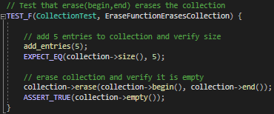
UNIT TESTING
Will the defined ‘erase’ function properly erase the vector ‘collection’?

Slide 9
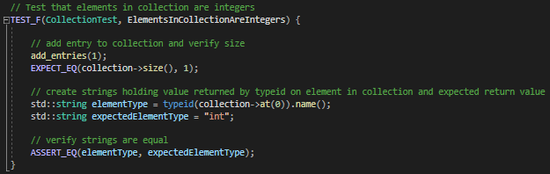
UNIT TESTING
Does the vector ‘collection’ contain only integers?

Slide 10
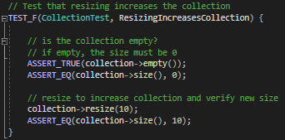
UNIT TESTING
Can the vector ‘collection’ be resized?

Slide 11
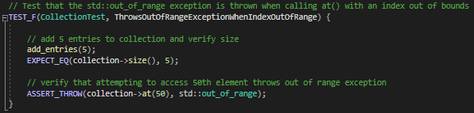
UNIT TESTING
Will an exception be thrown when attempting to access an out-of-bounds index of the vector ‘collection’?

Slide 12

AUTOMATION SUMMARY

Slide 13
AUTOMATION TOOLS OVERVIEW
The DevSecOps pipeline follows a system throughout its lifecycle and implies the implementation of secure practices from the earliest stages. Pre-production stages consist of designing, developing, and testing a system, while the production stages consist of monitoring, maintaining, and updating the system.
There are a wide array of tools designed to assist in the implementation and automation of secure practices throughout various stages of the DevSecOps pipeline.

Slide 14
PRE-PRODUCTION TOOLS
Design:
IriusRisk is a popular threat modeling tool. Additional tools such as Jira and Slack assist in issue tracking and communication.
Development:
Build phase analysis tools such as OWASP Dependency-Check and SonarQube are used to catch vulnerabilities during the build process.
Test:
Tools such as ZAP are often used for penetration testing, while others such as Codename SCNR analyze the behavior of web applications.

Slide 15
PRODUCTION TOOLS
Deployment and monitoring:
Tools such as Aqua Security and Checkmarx One are used to monitor a system throughout the entire development cycle, including well after it has been deployed. They represent an essential part of maintaining the security of systems by identifying threats and providing key insights to developers regarding how they can be improved.

Slide 16
RISKS AND BENEFITS
Acting Later:
Risks:
Higher cost to fix issues when found
Greater time spent in later stages
Potential for system to become unusable or impractical
Benefits:
Lower initial cost
Less time spent designing and developing
Acting Now:
Risks:
Higher initial cost
More time spent in earlier stages
Potentially wasted effort
Benefits:
Catch vulnerabilities earlier
Lower cost to fix found issues
Less time spent in later stages
Smaller risk of successful attacks

Slide 17
RECOMMENDATIONS
Static code analysis:
Tests should be run consistently after developing code
Tests should be used to ensure that all vulnerabilities are known before deployment
Version updates and interoperability
New iterations should ensure that the newest stable releases of libraries and packages are used to increase security
All libraries and packages used should be tested with each other to ensure interoperability before deployment
Continued monitoring and maintenance
Previously releases should be maintained and updated when flaws are discovered to prevent abuse of the system
Users should be encouraged to upgrade to newer system versions when they become available

Slide 18
CONCLUSIONS
The previously described standards represent a pathway for developers to ensure highly secure systems using a multi-layered approach.
These layers consist of implementing secure design patterns and development procedures, using automated tools to identify security risks early, monitoring and auditing the system to learn from it following deployment, and encouraging updates when flaws are discovered.
Using these strategies, our systems can be secure against attacks while effectively reaching their goals and remaining innovative for our users.

Slide 19
REFERENCES
Amazon. (n.d.). What is DevSecOps? Retrieved from https://aws.amazon.com/what-is/devsecops#:~:text=DevSecOps%
20is%20the%20practice%20of,is%20both%20efficient%20and%20secure.
Witts, J. (March 6, 2024). The Top 10 DevSecOps Tools for Application Security. Retrieved from https://expertinsights.com/insights/the-top-10- devsecops-tools-for-application-security/
Zettler, K. (n.d.). DevSecOps Tools: The DevSecOp tools that secure DevOps workflows. Retrieved from https://www.atlassian.com/devops/devops- tools/devsecops-tools

